Slide 1
Emplay Inc. Assessment Solution
06 December 2021
Narasimha Shastry K S
+91-6363975031
narasimha192000@gmail.com

Slide 2
Table of contents
Answer to Question 1 - Page 4 - 10
Answer to Question 2 - Page 11-26

Slide 3
Attachments In Zip File
Narasimha Shastry K S_Emplay Inc_Assignment Question 1.ipynb
Narasimha Shastry K S_Emplay Inc_Assignment Question 2.ipynb
Narasimha Shastry K S_Emplay Inc_Assignment PPT.pptx
Emplay INC Assessment.xls --- Question Worksheet

Slide 4
Question 1 Solution

Slide 5
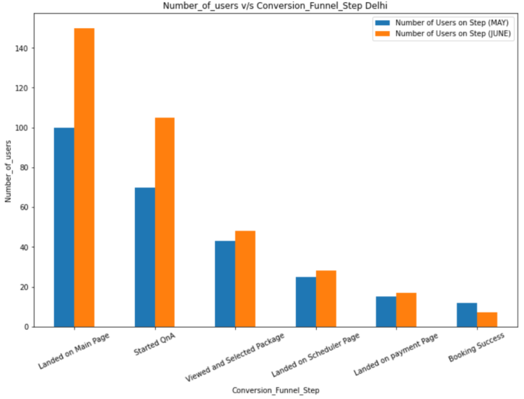
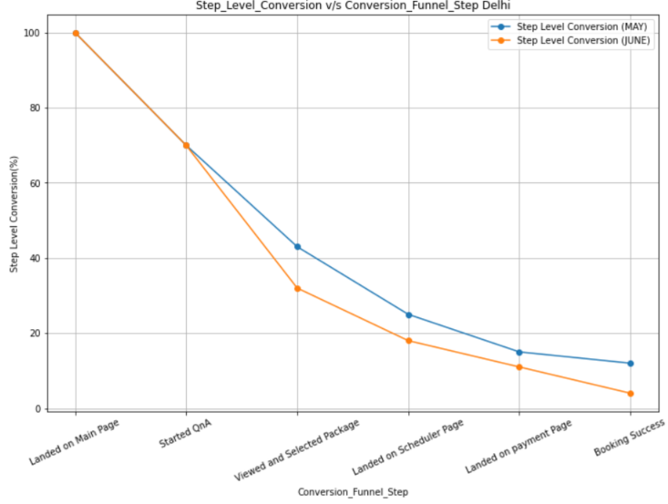
Question 1 Data Analysis
Delhi – Data Charts
Analysis
Bar graph shows the Number of Users vs Conversion Funnel Step for Delhi. Here we see that the Number of Users have increased for the month of June relative to May.
Line chart shows the Step Level Conversion vs Conversion Funnel Step for Delhi. The Step Level Conversion is captured in percentage and it is noted that, Step Level Conversion for May is higher compared to June

Slide 6
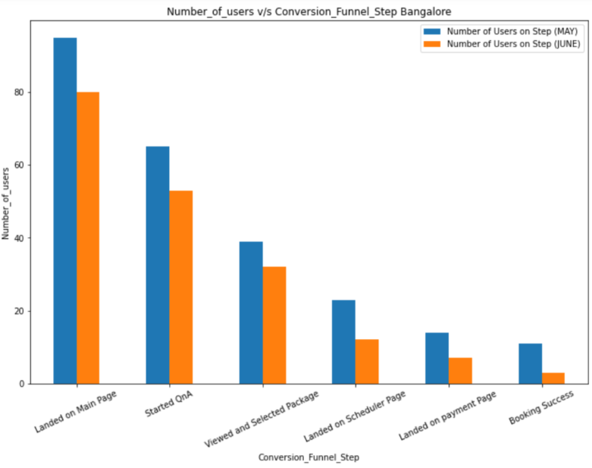
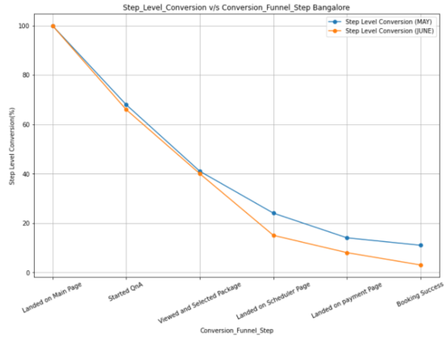
Bangalore – Data Charts
Analysis
Bar graph shows the Number of Users vs Conversion Funnel Step for Bangalore. Here we see that the Number of Users have higher for the month of May relative to June.
Line chart shows the Step Level Conversion vs Conversion Funnel Step for Bangalore. The Step Level Conversion is captured in percentage and it is noted that, Step Level Conversion for May is higher compared to June

Slide 7
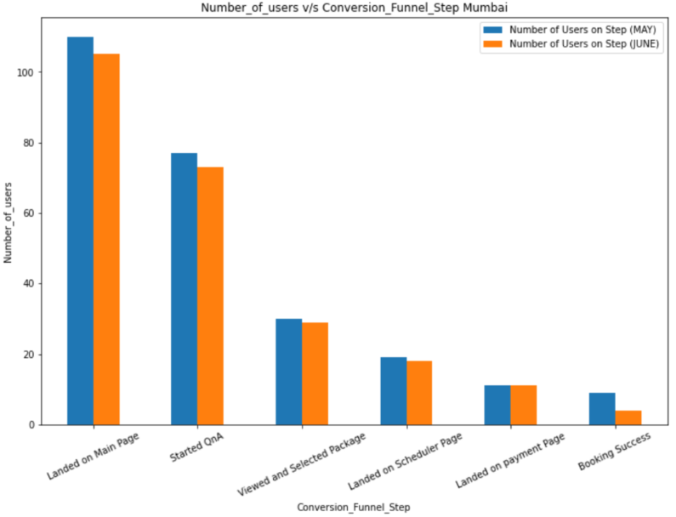
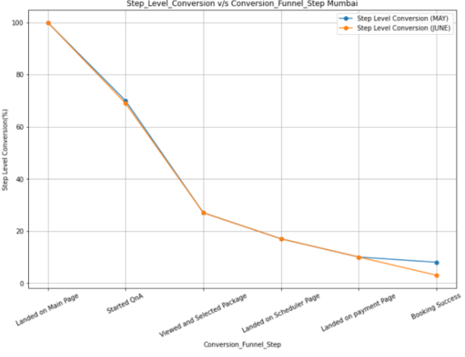
Mumbai – Data Charts
Analysis
Bar graph shows the Number of Users vs Conversion Funnel Step for Mumbai. Here we see that the Number of Users have higher for the month of May relative to June.
Line chart shows the Step Level Conversion vs Conversion Funnel Step for Mumbai. The Step Level Conversion is captured in percentage and it is noted that, Step Level Conversion for May and June are almost similar except for booking success

Slide 8
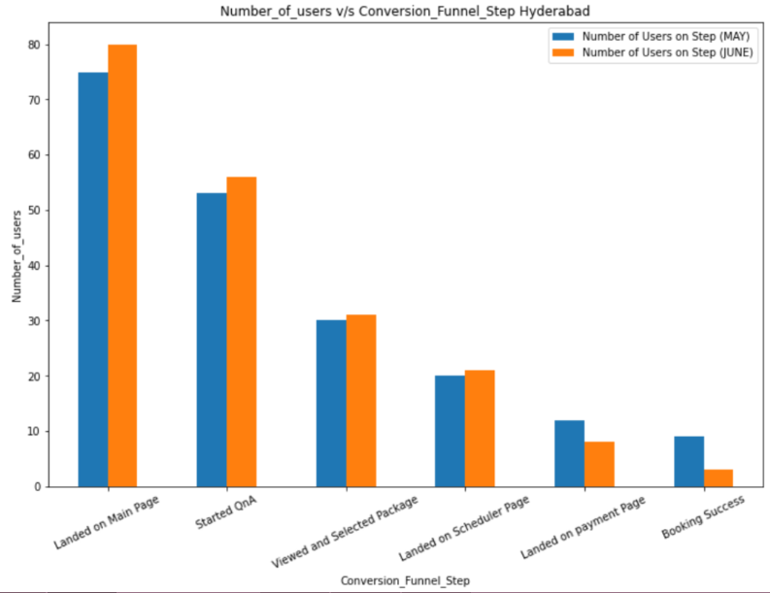
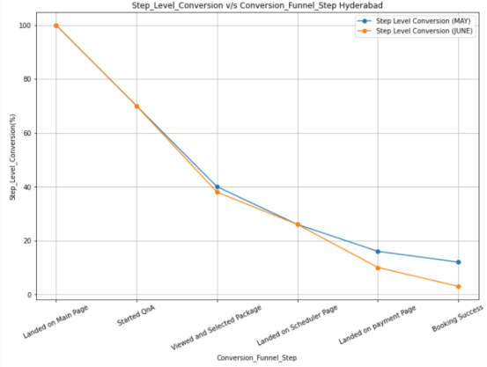
Hyderabad – Data Charts
Analysis
Bar graph shows the Number of Users vs Conversion Funnel Step for Hyderabad. Here we see that the Number of Users have higher for the month of June relative to May.
Line chart shows the Step Level Conversion vs Conversion Funnel Step for Hyderabad. The Step Level Conversion is captured in percentage and it is noted that, Step Level Conversion for May and June are almost similar except for payment page and booking success, for the same June has lower value

Slide 9
Question 1 (a) Solution
Solution to (a)
Low Conversion in Mumbai –
The reason for low overall conversion in Mumbai (8.2%), can be attributed to huge drop in “Viewed and Selected Package” conversion.
In Mumbai, 110 people land on the main age which is almost 10% more than Delhi and 13.6% more than Bangalore and 31.8% more than Hyderabad.
70% started QnA in Mumbai and this dropped to 27.3% in “Viewed and Selected Package”, there is a 43% drop. The possible reasons might be –
Pricing of service might be an issue, since cities are in different states with different cost of living. We have not been provided sufficient data to conclude that prices are differing.
Availability of services offered, might differ city to city. Which was observed when in the app.
Income disparity among the target population, Mumbai might have a more of lower middle class and middle class population which might not be able to afford the cost of services provided
Partners – The customer satisfaction is also dependent on skill and professional conduct of the partner arriving at the home. If the most highly skilled partners are unavailable then this will affect the booking success
Abundant availability of local brick and mortar solons and familiar hair specialist.

Slide 10
Question 1 (b) Solution
Solution to (b)
Dropped Conversion in June –
We see some major drop in following cities for conversion funnel step for June compared to May –
In Delhi, Viewed and Selected Package had a drop of 11%. Possible reason - The customer did not find suitable Packages for his/her range .
In Delhi, Landed on Scheduler Page had a drop of 6.3%. Possible Reason - The customer did not find suitable time slot as per his/her requirement.
In Delhi, Booking success had a drop of 7.3%. Possible Reason - The booking order was cancelled by the partner.
In Bangalore, Landed on Scheduler Page has a drop of 9.2%. Possible Reason - The customer did not find suitable time slot as per his/her requirement.
In Bangalore, Booking success Page has a drop of 7.8%. Possible Reason - The booking order was cancelled by the partner.
In Hyderabad, Landed on payment Page has a drop of 6%. Possible Reason - Technical glitch, unsuccessful payment.
In Hyderabad, Booking success Page has a drop of 8.2%. Possible Reason - The booking order was cancelled by the partner.

Slide 11
Question 2 Solution

Slide 12
Question 2
Libraries Imported
pandas
numpy
matplotlib.pyplot
DateTime
Data Pre-processing
Read the csv file to import data
Dropped unwanted columns
Checking for null values. No null values found in the dataset
1. Month-On-Month (MOM) User Acquisition Rate
Removed the duplicates for 'Profile ID' column in the dataset.
Converted 'Date_of_Booking' column to readable date format and extracted month name from it.
Ascertaining Number of Users for MOM User Acquisition Rate
To obtain the user acquisition rate we need to ascertain the users in that particular month – This was achieved by selecting single instance of customers in that particular month i.e. all the users who booked the slot in that month. For customers with multiple repetitions, duplicates were removed.

Slide 13
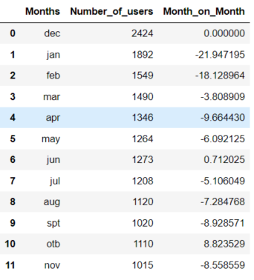
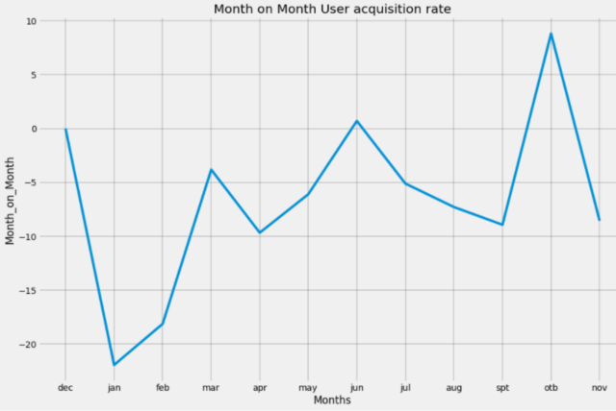
After Ascertaining Number of Users for MOM User Acquisition Rate, we proceeded to calculate the MOM User acquisition rate using the following Formula
MOM User Acquisition Rate = ((Number of Users in current month / Number of users in previous month)-1)*100
The results obtained are below –

Slide 14
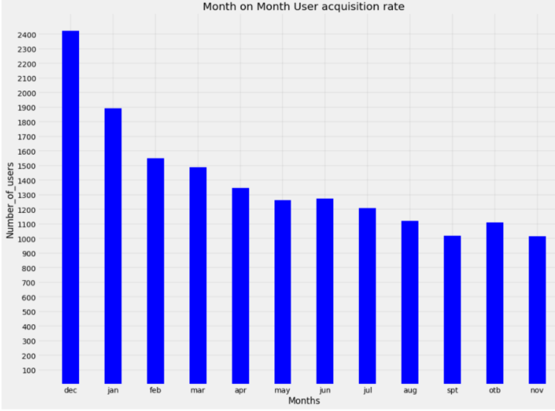
Analysis
Analysis of the graphs show us that, MOM user acquisition rate in January decrease 21% relative to users in December, this rate continues to show a negative trend in February and shows a positive trend hinting recovery in month of March. Only the month of June has a slight positive growth/ improvement of 0.71% relative to previous month. Month of October shows positive recovery with a Rate of 8.8%increase in MOM user acquisition rate.

Slide 15
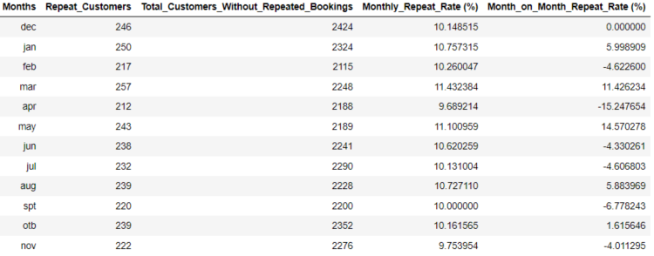
2. Month on month repeat rate
Repeat rate is defined as Number of customers who have shopped more than once by total number of customers.
To obtain the Number of repeat customers, we first proceed to find the count of bookings of repeat customers i.e. the repeat customers have multiple booking slots in the same month. Now, isolating the multiple booking and considering the first instance of such multiple bookings and removing the duplicates will provide us the repeat customers.
To find the Total number of customers, we simply remove the multiple instances of repeating customers considering only a singular occurrences (keeping the first instance of the customer).
Repeat Rate = No of customers who have shopped more than once / Number of customers
Table with Monthly Repeat Rate and Month on Month Repeat rate (formulas in next slide), note negative sign indicates a fall in percentage (negative trend) with respect to previous month

Slide 16
Monthly_Repeat_Rate (%) = Repeat_Customers for that month/ Total_Customers_Without_Repeated_Bookings for that month
Month_on_Month_Repeat_Rate (%) = (((Monthly_Repeat_Rate (%) current month/ Monthly_Repeat_Rate (%) previous month)-1)*100)
Analysis –
We see there is a positive trend in the MOM repeat rate from Dec to Jan with 6%, then we see an negative trend or fall in repeat rate in Feb compared to Jan. We the see 11% growth in March with respect to Feb. April has the largest negative trend with drop of 15%. The line graph in next slide indicates the MOM trends.

Slide 17
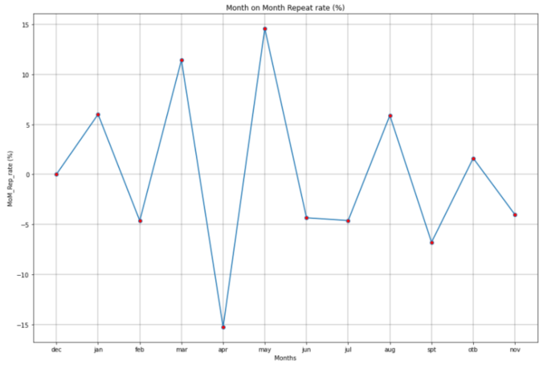
For more graphs an analysis refer to “Narasimha Shastry K S_Emplay Inc_Assignment Question 2.ipynb” file

Slide 18
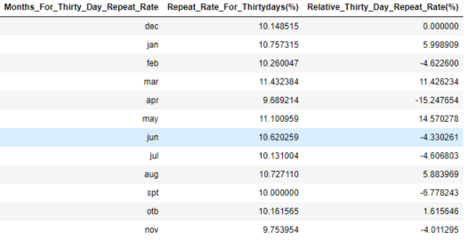
Repeat Rates - 30-Day repeat rate, 60-Day repeat rate and 90-Day repeat rate
Definitions
30-Day repeat rate - Repeat_Customers for 30 Days/ Total_Customers_Without_Repeated_Bookings for 30 Days
60-Day repeat rate - Repeat_Customers for (60 Days or 2 months)/ Total_Customers_Without_Repeated_Bookings for (60 Days or 2 months)
90-Day repeat rate - Repeat_Customers for (90 Days or 3 months)/ Total_Customers_Without_Repeated_Bookings for (90 Days or 3 months)
30-Day repeat rate Table

Slide 19
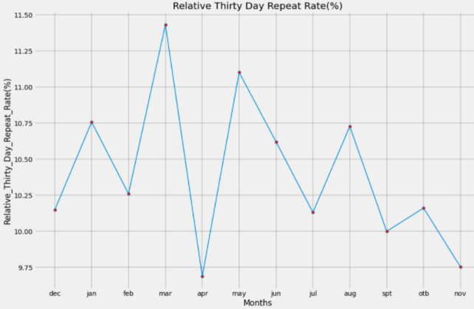
30-Day repeat rate line graph
We are comparing previous 30 day period to next 30 day period in this analysis. This chart shows the trends for consecutive 30 day period.

Slide 20
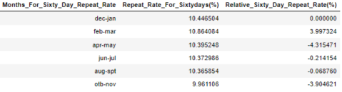
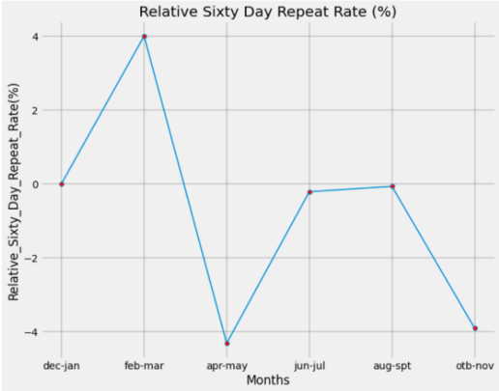
60-Day repeat rate line graph
We are comparing previous 60 day period to next 60 day period in this analysis, as in we are combining two months Dec-Jan and Feb-Mar, to obtain data for 60 day period. Then this is used to determine the trend in 60 day period This chart shows the trends for consecutive 60 day period.

Slide 21

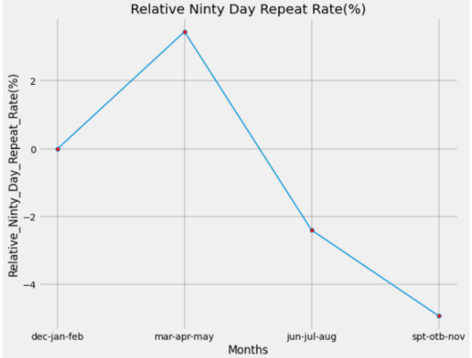
90-Day repeat rate line graph
We are comparing previous 90 day period to next 90 day period in this analysis, as in we are combining two months Dec-Jan-Feb and Mar-Apr-May, to obtain data for 90 day period. Then this is used to determine the trend in 90 day period This chart shows the trends for consecutive 90 day period.

Slide 22
4. Best repeat rate metric among 30-Day repeat rate, 60-Day repeat rate and 90-Day repeat rate
As we observe data and charts in question 3, it is effective to use 30 day repeat day metric as we can keep track of repeated users, if we find a declining trend, strategy can be tuned to correct the course of customer repetition aspect.
For example, If we find there is a drop in repeat rate in repeat rate in May compared to February, we can bring in service at lower price to attract customers or bring in most liked services to retain customers.
On the contrary, if we choose to use 60 day or 90 day repeat rate, the business will not be agile enough to bring in changes to steer the customer repetition rate.
Additionally in 30-Day repeat rate we get feedbacks which helps in assisting customers on a regular basis, the company will be able to address customer inconvenience faster. With 60 day and 90 day repeat metric the feedback will pile up and this might add on to customer dissatisfaction.
Thus, we can conclude 30 day repeat rate is the better option.

Slide 23
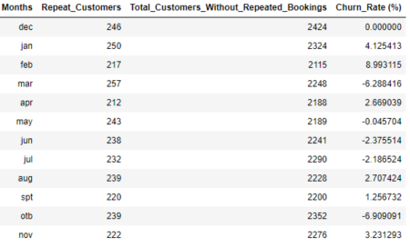
5. Definition of Churn Period and monthly Churn rate
Churn Period - The churn rate, also known as the rate of attrition or customer churn, is the rate at which customers stop doing business with an entity. It is most commonly expressed as the percentage of service subscribers who discontinue their subscriptions within a given time period.
We have considered churn rate for a period of 30 days or a month.
Monthly Churn Rate = (Loss of customers/number of customers)*100
Analysis
Table shows there is a positive churn rate from Dec to Jan of 4.12%, i.e. 4.12% of customers have dropped off. Observing closely we see that in March the there is a negative trend in churn rate of 6.2%, i.e. 6.2% customers have joined the business and there is no loss, which is a positive growth for business. See line graph in next slide

Slide 24
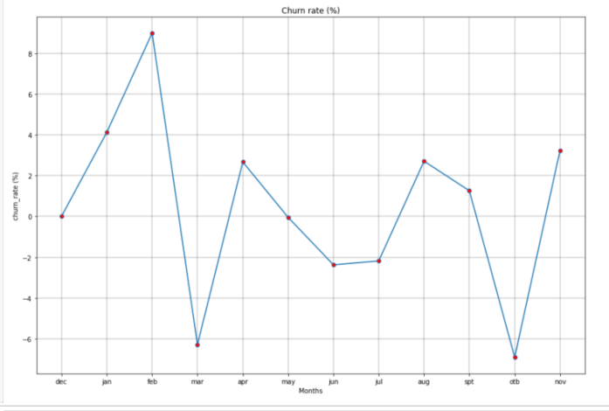
Churn Rate % line graph

Slide 25
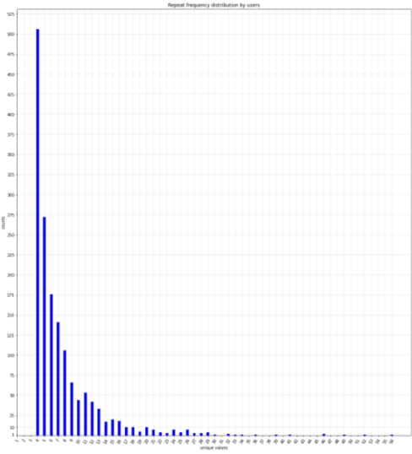
6. Repeat Frequency Distribution by users
For data table with repeat frequency distribution refer to “Narasimha Shastry K S_Emplay Inc_Assignment Question 2.ipynb” file “SOLUTION FOR QUESTION 6”, if data points are not clearly visible
Graph indicates the repeat frequency distribution by users, from the data in Juypter Notebook file, we see that, one individual has repeated 56 times which is the highest with profile ID 9066, Multiple individuals 12020 have booked the service once

Slide 26
7. Why certain users are repeating and certain users are not?
We observe from the data that one individual has repeated 56 times which is the highest with profile ID 9066, and most of the individuals(12020) have booked the services only once.
Since we have a total of 16711 users, and 12020 have availed the service only once, we have repeated the 4691 individuals repeating the services. i.e. 28% have repeated.
The reasons for repetition may be –
Cost effective services
Ease of availability – Home services provided
Effective advertisement on limited social media platforms like Google Facebook etc. – This is evident from the ”Source” column in the data set.
Services provided can be availed on requested date and requested hour, this is evident from the “Slot of Booking (Hour of the Day)” column and “Date_of_Service_Requested” column we can observe that the slots have bee booked from 6th hour to 19th hour. This feature is important for demographic that is employed or working class.
The reasons for not repeating may be –
Unsatisfied user experience
From column “Source”, only 4 (A,B,C,D) are the social platforms, this number has to be increased.
Older population in society may still stick on to brick and mortar shops
Difficulty in using the app or website for senior population

